Slide 1

COMP 90049
Knowledge Technologies
Week 8
我们毕业啦
其实是答辩的标题地方
Tutor
Ang Li

Slide 2
Name: Ang Li
E-mail: angl4@student.unimelb.edu.au
Contact information
Research topic: computer vision

Slide 3
Summery
Work through this week’s exercise
Notes:
Secure File Transfer Protocol
Secure Shell

Slide 4
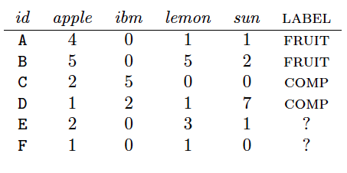
Exercise 1. Treat the problem as an unsupervised machine learning problem (excluding the id and label attributes), and calculate the clusters according to k -means with k = 2, using the Manhattan
distance:
Starting with seeds A and D .

Slide 5
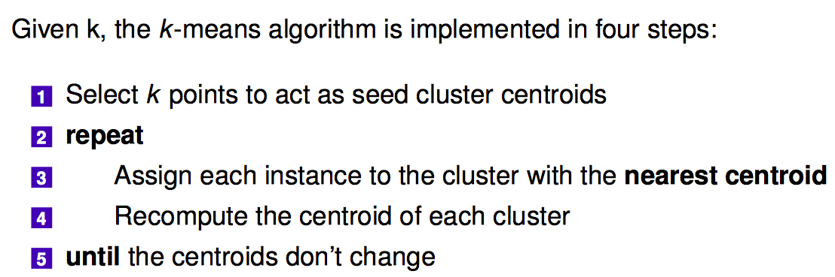
K-means

Slide 6

We begin by setting the initial centroids for our two clusters, let's say cluster 1 has centroid C1 = < 4, 0, 1, 1> and cluster 2 C2 = < 1, 2, 1, 7>
We now calculate the distance for each instance to the centroids of each cluster:

Slide 7
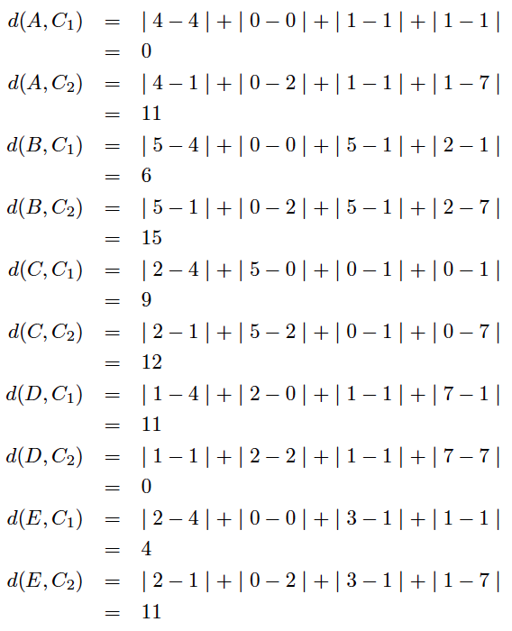
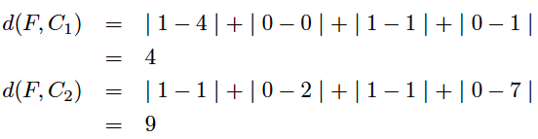

Slide 8
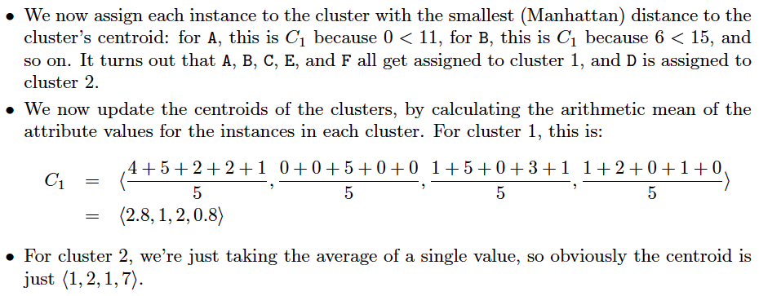

Slide 9
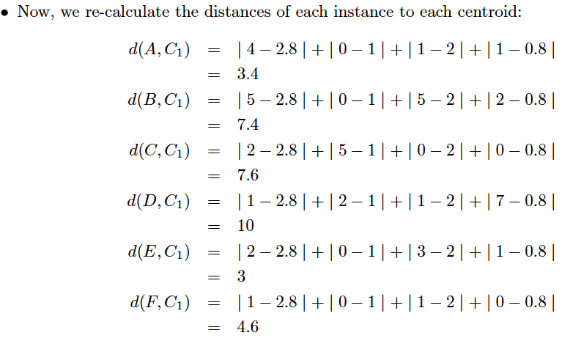

Slide 10
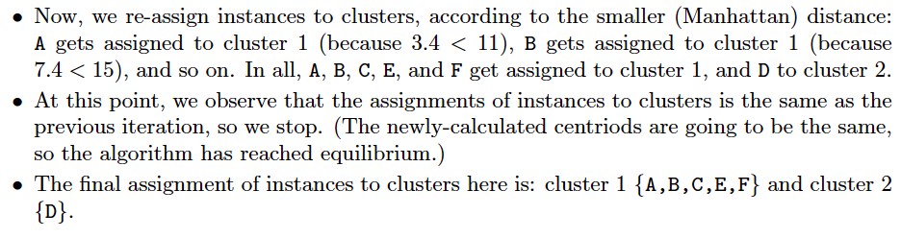

Slide 11
Exercise 2. Perform agglomerative clustering of the above dataset (excluding the id and label attributes),
using the Euclidean distance and calculating the group average as the cluster centroid.

Slide 12
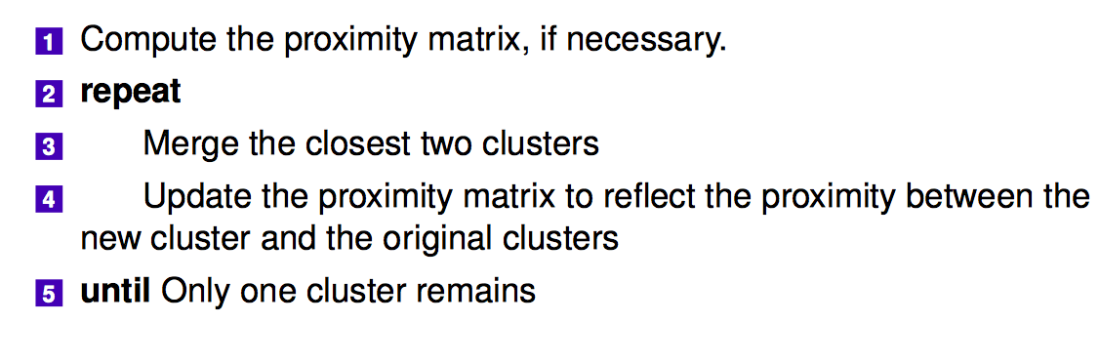
agglomerative clustering

Slide 13
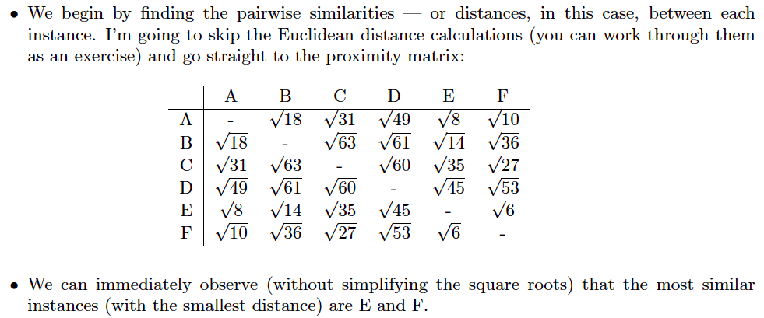

Slide 14
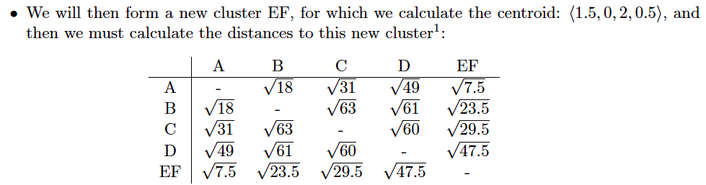

Slide 15
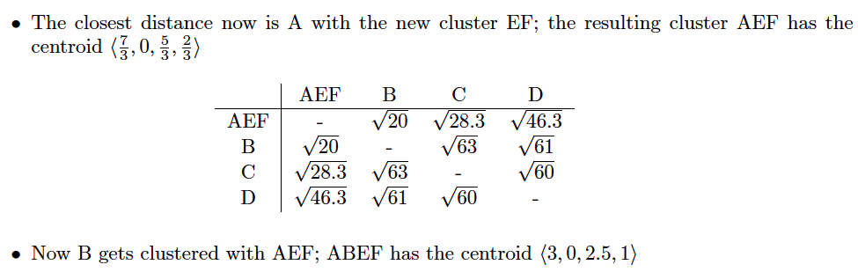

Slide 16
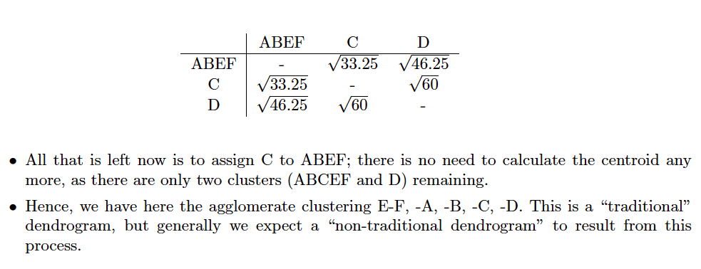

Slide 17
Exercise 3. What is overfitting ? What does it mean for a classier to generalize ?

Slide 18
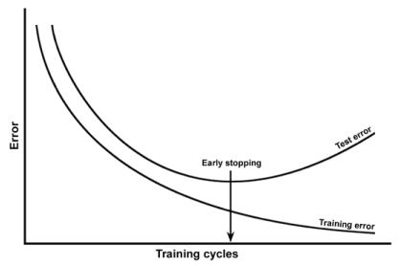
A classier “generalizes" when it learns the target function well, rather than the specifics of the training set.
Overfitting is when the classier fails to generalize: it builds a model which describes the training data very well, but doesn't describe the test data well.

Slide 19
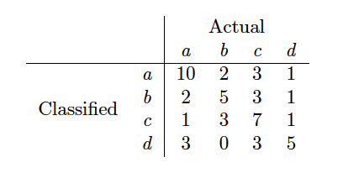
Exercise 4. A confusion matrix is a summary of the performance of a (supervised) classier over a set of
development (“test") data, by counting the various instances:
Calculate the classification accuracy of the system. Find the error rate for the system.

Slide 20
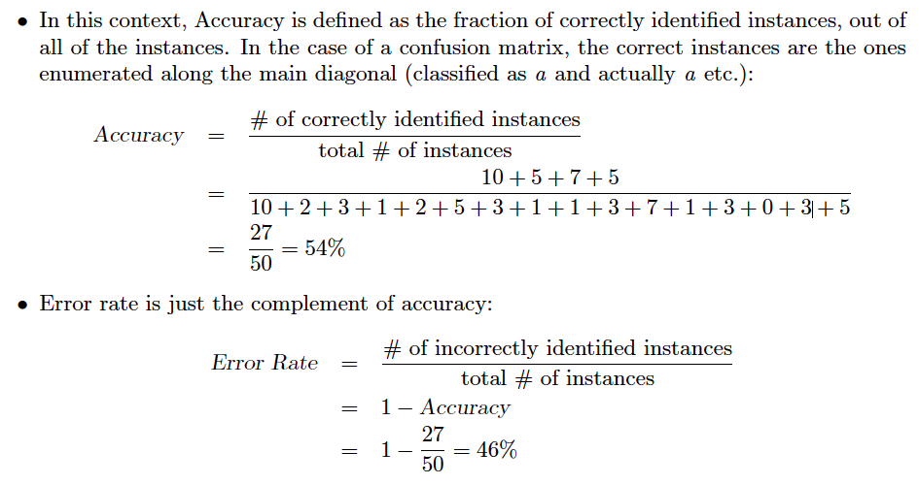

Slide 21
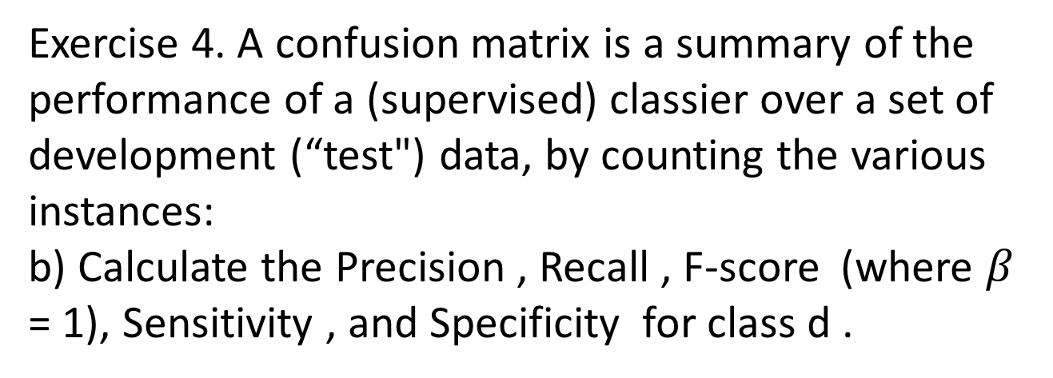
Exercise 4. A confusion matrix is a summary of the performance of a (supervised) classier over a set of
development (“test") data, by counting the various instances:
b) Calculate the Precision , Recall , F-score (where $β$ = 1), Sensitivity , and Specificity for class d .

Slide 22
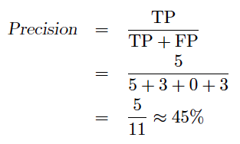
Precision for a given class is defined as the fraction of correctly identified instances of that class.
The true positives (TP) where we attempted to classify an item as an instance of the said class (here, d), and it was actually of that class (d ), there are 5 here.
The false positives (FP) are those items that we attempted to classify as being of class d , but they were actually of some other class: there are 3 + 0 + 3 = 6

Slide 23
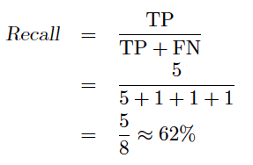
Recall for a given class is dened as the fraction of correctly identified instance of that class.
The true positives (TP) where we attempted to classify an item as an instance of the said class (here, d), and it was actually of that class (d ), there are 5 here
The false negatives (FN): those items that were actually of class d , but we classied as being of some other class; there are 1 + 1 + 1 = 3

Slide 24

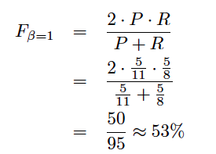
F-score is a measure which attempts to combine Precision (P) and Recall (R) into a single score.

Slide 25
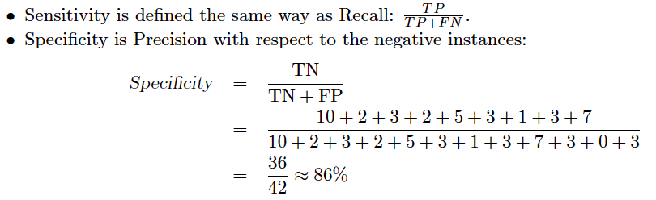

Slide 26
Exercise 5. How is holdout evaluation different to cross-validation evaluation?

Slide 27
In a holdout evaluation strategy, we partition our data into a training set and a test set: we build the model on the former, and evaluate on the latter.
In a cross-validation evaluation strategy, we do the same as above, but a number of times, where each iteration uses one partition of the data as a test set and the rest as a training set (and the partition is different each time). The evaluation metric is typically averaged across the various partitions.

Slide 28
Thanks!

